Slide 1
Preliminary Analysis of CRE EW
Oct 2018

Slide 2
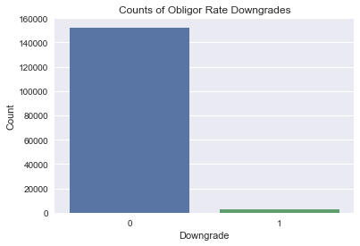
Sampling Methodology and Analysis
I. Original Dataset
BTM Borrower Rtg Analysis
Detecting the downgrade case by comparing the rating of adjacent period for each obligor.
2693 downgrade cases for overall 152259 per obligor/ time-period documented ratings.
Percentage of downgrade cases is 0.000657.
Downgrade notch is calculated for each downgrade case.
Market Indicators (Original Dataset)
EDF Implied BTMU Rating | EDF Notch | EDF Value | Notch Diff EDF Implied vs BTMU
CDS Implied BTMU Rating | CDS Spread (5yr) | Notch Diff CDS Implied vs BTMU
Moody’s Implied BTMU Rating | Moody’s LT Rating | Notch Diff Moodys Implied vs BTMU
S&P Implied BTMU Rating | S&P LT Rating
BIR
Secondary Loan Average Price

Slide 3
Net Downgrade Intensity

Slide 4
Observations
Strategies:
1. Tie the market variable and target variable data by ‘Date’, ‘Property Type’ and ‘Region’
2. Investigate and model on the level of ‘Date’ and ‘Property Type’
Data issues:
Different geographic regions for market variable and target variable data.
Market variable data
2. Missing values for market variable data

Slide 5
Market variables data:

Slide 6
Correlation analysis for market variables with probability of default
Correlation analysis between market variables

Slide 7
Modeling Approach
Predict probability of default for customers on each time point
Calculate downgrade intensity for all time points
Compare with historical downgrade intensity
(the predicted downgrade intensity should be predictable to the historical ones)
Data Requirements:
Predict downgrade intensity directly
3. Compare the prediction with the historical downward intensity
Data Requirements:
(market variables with )

Slide 8
Gantt Chart
Key Milestones:
1) Data acquisition: (CPM & CSG) (Ongoing) 2) Data quality check and screening (might involve some iterations with Risk Tech team): ( CSG and Risk Tech) (Ongoing) 3) Existing process rerunning and results presentation: (CSG & CPM) (Done) 4) Existing process rerunning by incorporating new data fields and results presentation: (CSG & CPM) (Ongoing) 5) Improvements exploration, further analysis and plans discussion: (CSG & CPM) (Started) 6) Developments and Implementation: (CSG & CPM) (To Start)

Slide 9
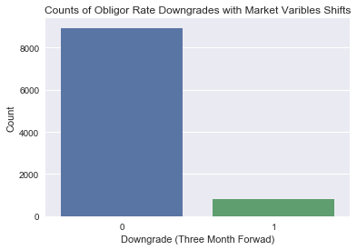
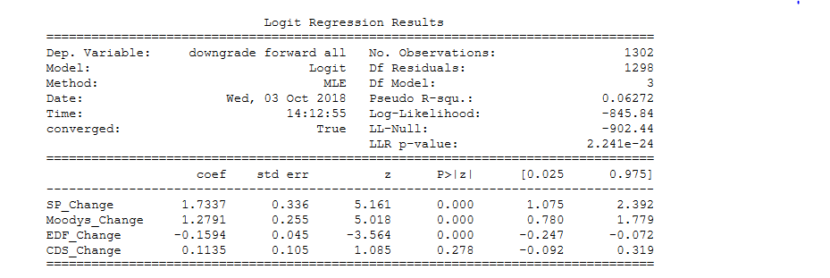
Sampling Methodology and Analysis
II. Sampling Methodology and Modeling
Market Indicator Selection and Preparation
EDF Implied BTMU Rating, CDS Implied BTMU Rating, Moody’s Implied BTMU Rating, S&P Implied BTMU Rating.
Sampling per obligor/ time period when any of the interested indicators makes change.
Calculating the change of interested variables
Downgrade and Downgrade Notch Analysis
814 downgrade cases for overall 9755 selected per obligor/ time-period based on market indicator changes.
Percentage of downgrade cases is 0.01 in the sampling.
The coverage of downgrade cases in the sampling is (814/ 2963) *100% = 27.47%
Logistic Regression for Downgrade Class Prediction
Predictors: the change of four BTMU implied rating (EDF Implied BTMU Rating, CDS Implied BTMU Rating, Moody’s Implied BTMU Rating, S&P Implied BTMU Rating).
Dependent variable 0: The CDL customer is not downgraded at the time point
1: The CDL customer is downgraded at the time point or within three time periods forward.

Slide 10
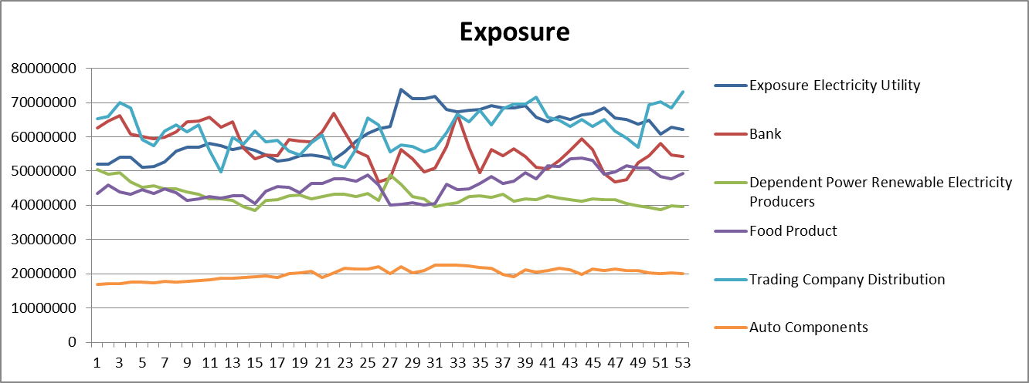
Industry Grouping for CDL Customer ID
Mapping each CDL Customer ID into industries based on GICS.
* Industries with over 3000 appearances in the data are selected (multiple obligors are included )
Analyze the downgrade intensity by industries.
Detecting the trend of market variables by industries for CDL Customers.
Industries | Electricity Utility | Bank | Independent Power Renewable Electricity Producers | Food Product | Trading Company Distribution | Auto Components
No Downgrade Counts | 8751 | 7894 | 4291 | 3464 | 3402 | 11827
Downgrade Counts | 135 | 59 | 59 | 59 | 71 | 187
Downgrade Percentage | 1.52% | 0.74% | 1.36% | 1.67% | 2.04% | 1.56%
Market Variable Trends

Slide 11
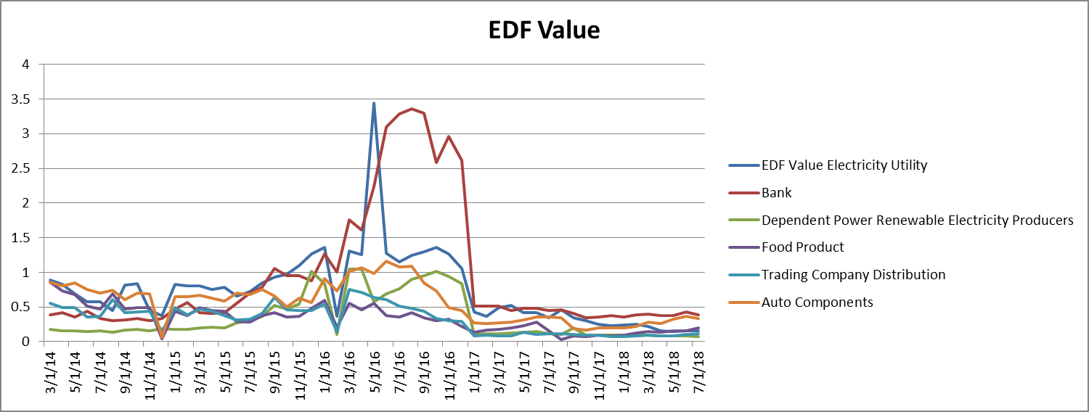
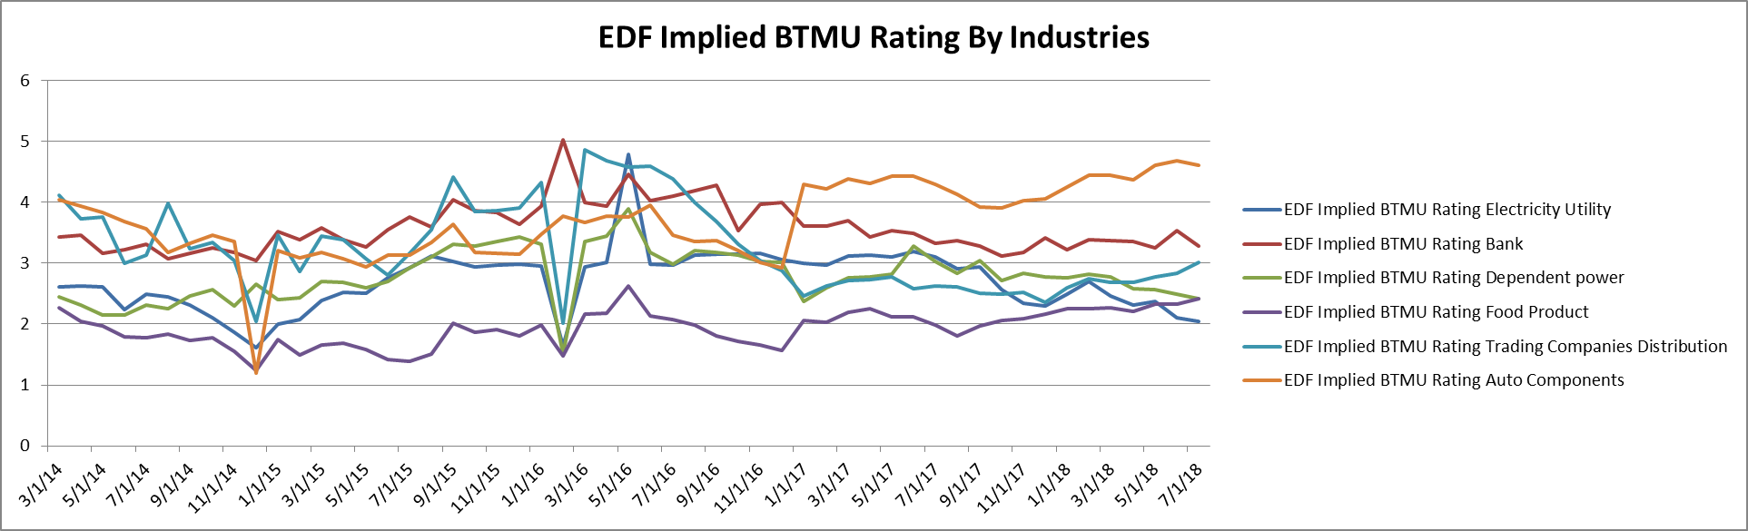

Slide 12
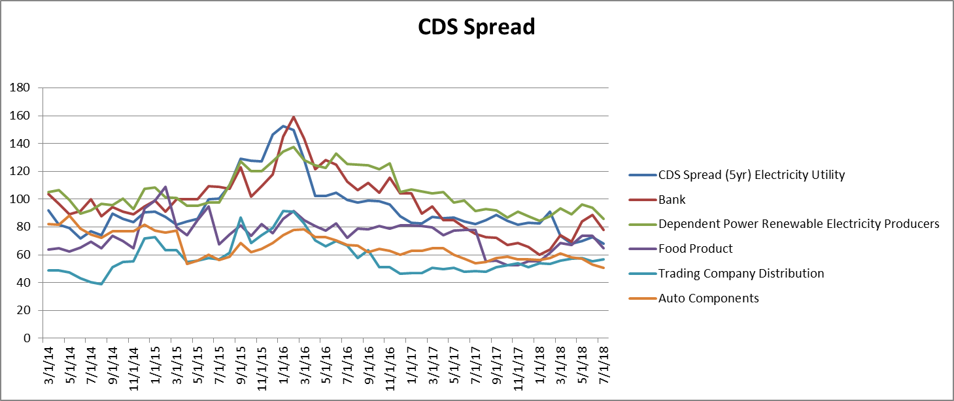
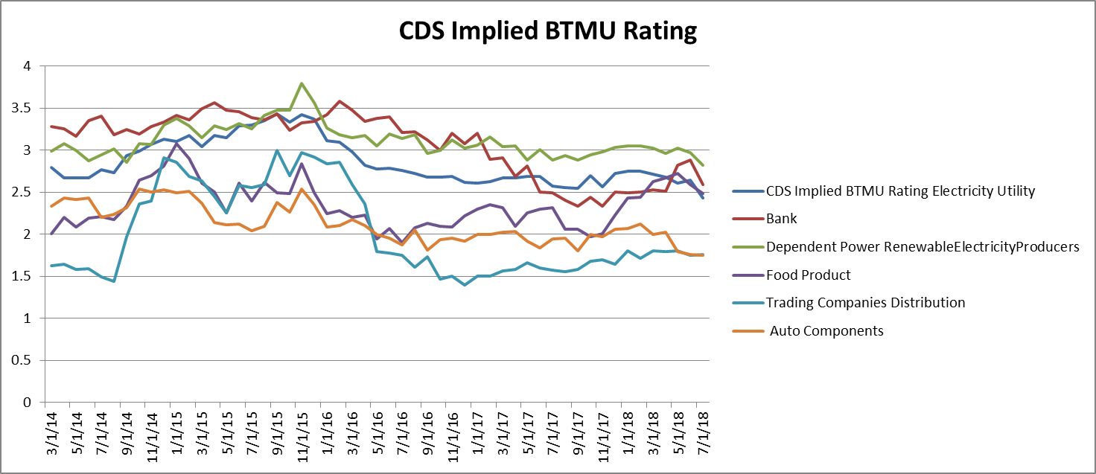

Slide 13
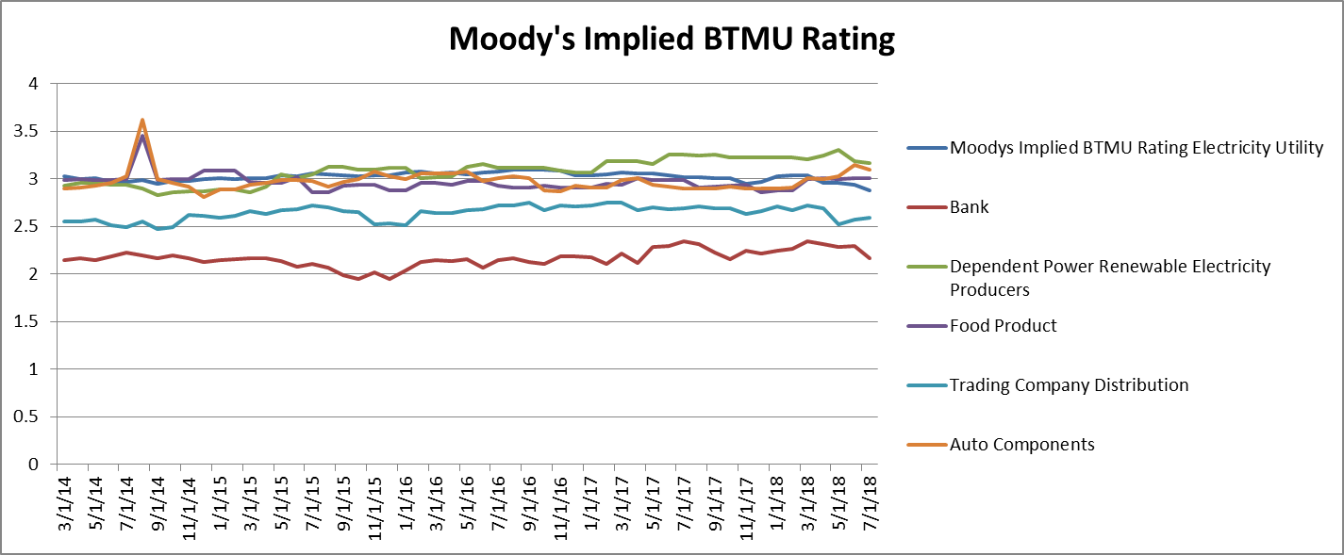
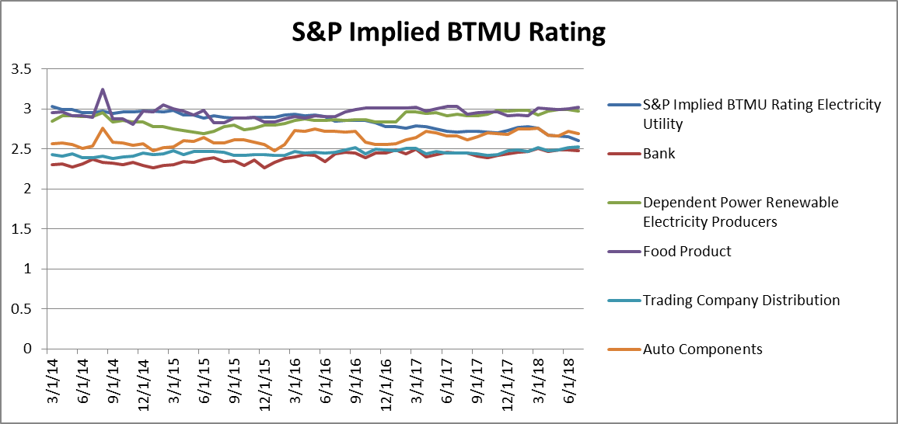

Slide 14
Summary & Next Step

Slide 15
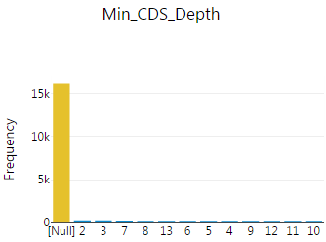
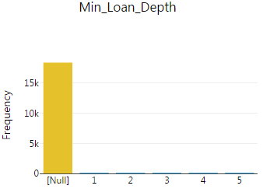
Quick View of EWS Back testing for FY 2017
II. Predictor Severity vs Reliability
Exploring the effects on applying scenarios or filters
We can apply various filters or scenarios to restructure the trigger criteria.
we can also segregate obligors by rating/industry and apply thresholds or sensitivity for triggers differently.
Predictor Severity vs. Reliability (Difference Bucket Based)
Below is the % of BTMU downgrade when predictors reported different notches of downgrade 3 months ahead.
There is reasonable correlation between the severity of a trigger breach and the possibility of a rating downgrade. For example, the higher the differential between MUFG internal ratings and market implied ratings, the likelier a downgrade will result.
Implied Notch Diff |  |  | 0 | 1 | 2 | 3 | 4 | 5 | 6 | 7
EDF | 2010 |  | 5% | 5% | 6% | 6% | 10% | 0% | 0% | 0%
 | 2011 |  | 3% | 2% | 4% | 4% | 2% | 20% | 0% | 0%
 | 2012 |  | 2% | 3% | 9% | 12% | 3% | 11% | 100% | 0%
 | 2013 |  | 1% | 5% | 3% | 9% | 23% | 0% | 0% | 0%
 | 2014 |  | 3% | 4% | 6% | 4% | 0% | 0% | 0% | 0%
 | 2015 |  | 0% | 0.5% | 0% | 7.3% | 25.7% | 31.5% | 20% | 0%
 | 2016 |  | 0% | 0% | 0% | 9.9% | 19.3% | 14.6% | 28.6% | 100.0%
 | 2017 |  |  |  |  | 4.8% | 4.3% | 2.1% | 6.3% | 20.0%
CDS | 2010 |  | 8% | 17% | 7% | 0% | 0% | 0% | 0% | 2%
 | 2011 |  | 6% | 11% | 18% | 0% | 6% | 0% | 0%
 | 2012 |  | 7% | 7% | 13% | 13% | 27% | 67% | 0% | 21%
 | 2013 |  | 2% | 3% | 4% | 5% | 5% | 0% | 0% | 0%
 | 2014 |  | 4% | 2% | 0% | 7% | 6% | 4% | 0% | 0%
 | 2015 |  | 0% | 0% | 6.7% | 5.2% | 10.9% | 5.9% | 20.4% | 14.3%
 | 2016 |  | 0% | 0% | 13.2% | 11.8% | 27.2% | 28.7% | 40% | 30.8%
 | 2017 |  |  |  | 3.9% | 6.1% | 4.1% | 16.7% | 0% | 0%
 |  | D |  |  | 12 | 6 | 2 | 5 | 0 | 0
 |  | T |  |  | 304 | 99 | 49 | 30 | 23 | 6
Moody’s | 2010 |  | 4% | 0% | 0% | 0% | 0%
 | 2011 |  | 7% | 60% | 0% | 0% | 0%
 | 2012 |  | 5% | 0% | 75% | 0% | 0%
 | 2013 |  | 5% | 0% | 0% | 0%
 | 2014 |  | 4% | 5% | 0% | 0%
 | 2015 |  | 0% | 0% | 5.3% | 23.1%
 | 2016 |  | 0% | 0% | 24.8% | 5.9% | 100% | 0%
 | 2017 |  |  |  | 2.3% | 8.3% | 100.0% | 0%
S&P | 2010 |  | 0% | 8% | 0%
 | 2011 |  | 2% | 8% | 0%
 | 2012 |  | 14% | 75% | 0%
 | 2013 |  | 21% | 0% | 0%
 | 2014 |  | 8% | 0% | 0%
 | 2015 |  | 0% | 0% | 15%
 | 2016 |  |  |  | 66.7% | 100%
 | 2017 |  |  |  | 0% | 25.0% | 7.7%
Depth Filters for CDS: Depth > 4
Implied Notch Diff |  |  | 0 | 1 | 2 | 3 | 4 | 5 | 6 | 7
CDS | 2017 |  |  |  | 5.2% | 7.5% | 4.2% | 27.8% | 0% | 0%
 |  | D |  |  | 12 | 6 | 2 | 5 | 0 | 0
 |  | T |  |  | 230 | 80 | 48 | 18 | 11 | 6
Depth Filters for Loan Price Change: Depth > 4
Price change |  | 0-0.5 | 0.5-1 | 1-1.5 | 1.5-2 | 2-2.5 | 2.5-3 | 3+
Loan | 2017 | 1.5% | 2.6% | 0% | 28.6% | 20% | 0% | 14.3%
BTMU Downgrades |  | 15 | 2 | 0 | 2 | 1 | 0 | 1
Loan Price Change Triggers |  | 1,015 | 78 | 10 | 7 | 5 | 8 | 7
Price change |  | 0-0.5 | 0.5-1 | 1-1.5 | 1.5-2 | 2-2.5 | 2.5-3 | 3+
Loan | 2017 | 1.5% | 2.6% | 0% | 28.6% | 20% | 0% | 14.3%
BTMU Downgrades |  | 15 | 2 | 0 | 2 | 1 | 0 | 1
Loan Price Change Triggers |  | 977 | 77 | 10 | 7 | 5 | 8 | 7
* Based on current Loanx ID to CDL mapping or CDS Red code to CDL mapping, it’s substantially subject to missing mapping when applied older history dates.

Slide 16
Data Map, Observations and Strategy
OBIEE Risk Tech Data:
SNP, Moody’s, CDS, Loan
From 03/2014
(1)
CDL customers are systematically with external rating data.
Moody’s ID vs CDL:
533 CDLs are able to map to Moody’s Obligors
Moody’s Default DB:
Obligors and Debt Ratings as early as 1920
BTMU SuperDealFile:
BTMU instrument data from 03/2013
CDL System
7571 (about 24.8%) of CDL can be mapped
(2)
Can be linked very well by Moody’s ID
Moody's Historic BIR Data:
Historical Bond Rating data from 08/2001
Observations:
SNP, Moody’s and CDS suggest to be relatively more predictive
Current EWS doesn’t have notch threshold and sensitivity tuned, thus the performance is not optimized.
Strategy:
(1) regression and inference approaches: Pros: systematical data set by CDL for quick modeling; Cons: short length of data, limited # of variables
Segmentation to classify different obligor groups for different sets of criteria.
Possibility of introduce other group-specific indicators, such as SNP supercomposite, CDS and EDF indexes by industry and investment grade?
(2) Utilizing Moody’s Default DB and other public market variables to build EWS for public companies: Pros: complete length of data set; Cons: whether this will apply to BTMU customers?
Data issue:
Depth data are not linked properly due to the lack of linkage among Red Code, Loan Ticker and CDL
Resolution is obtained: OBIEE maintains the mapping and CSG is getting the access (10/3).
Next step: Currently, the mapping is as of current date; it would introduce missing mapping when applied retrospectively. We will download and apply historical mapping once access to OBIEE is granted. In that case, Loan depth and CDS depth will be more complete.
BIR is linked with CDL by Moody’s ID. But for some reason, the data quality is low

Slide 17
Analysis case: Logistic regression to project possiblity of BTMU downgrades
I. Market Indicators Selection and Preparation
Market indicators from Risk Tech: EDF Implied BTMU Rating, CDS Implied BTMU Rating, Moody’s Implied BTMU Rating, S&P Implied BTMU Rating.
Extract downward changes of market indicators: cases when any of the market indicators changes downward, and the size of changes.
Evaluate occurrence of BTMU downgrade: the outcome that BTMU downgraded the obligor within next 3-month is considered to be the target event to early warn
II. Downgrade and Downgrade Notch Analysis
814 BTMU downgrades occurred in the total 9,755 Obligor-Month-Year records given any of the 4 market indicator changes.
Percentage of downgrade cases is 814/9755 = 8% in the sample data.
III. Logistic Regression for Downgrade Class Prediction
Predictors: the size of changes of 4BTMU implied ratings
Dependent variable: 0: The CDL customer is not downgraded at the time point
1: The CDL customer is downgraded at the time point or within three time periods forward.
IV. Performance
Accuracy: 56% (Accuracy= correctly projected downgrade and no downgrade cases/ Total cases)
Precision: 37% (Precision= actual downgrades / total triggers)
Recall: 57% (Recall= downgrades preceded by triggers / actual downgrades)

Slide 18
Proposed Project Gantt Chart
Key Milestones:
1) Data acquisition: (Risk Tech) (Ongoing) 2) Data quality check and screening (might involve some iterations with Risk Tech team): ( CSG and Risk Tech) (Ongoing) 3) Existing process rerunning and results presentation: (CSG & CPM) (Done) 4) Existing process rerunning by incorporating new data fields and results presentation: (CSG & CPM) (Ongoing) 5) Improvements exploration, further analysis and plans discussion: (CSG & CPM) (Started) 6) Developments and Implementation: (CSG & CPM) (To Start)

Slide 19
Appendix and Archives

Slide 20
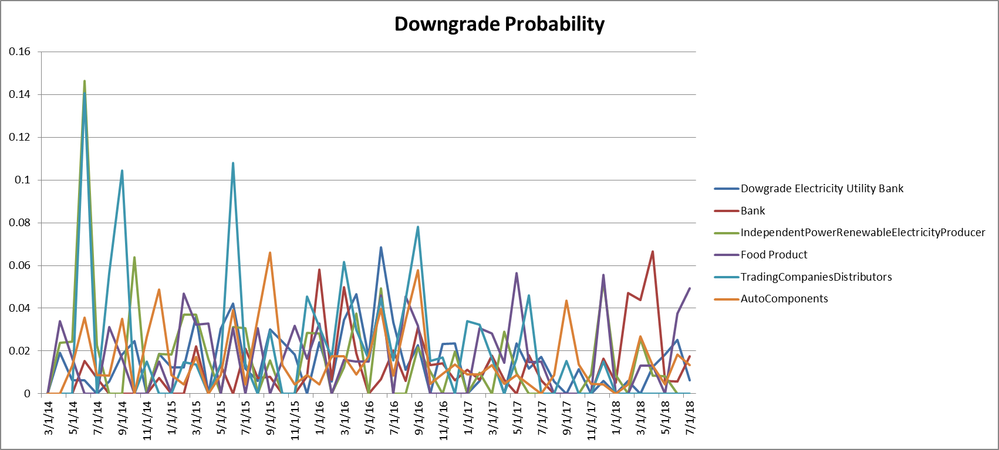
Industry Grouping for CDL Customer ID
Mapping each CDL Customer ID into industries based on GICS.
* Industries with over 3000 appearances in the data are selected (multiple obligors are included )
Analyze the downgrade intensity by industries.
Detecting the trend of market variables by industries for CDL Customers.
Industries | Electricity Utility | Bank | Independent Power Renewable Electricity Producers | Food Product | Trading Company Distribution | Auto Components
No Downgrade Counts | 8751 | 7894 | 4291 | 3464 | 3402 | 11827
Downgrade Counts | 135 | 59 | 59 | 59 | 71 | 187
Downgrade Percentage | 1.52% | 0.74% | 1.36% | 1.67% | 2.04% | 1.56%
Downgrade Trends

Slide 21
Market Variable Trends

Slide 25
Quick View of EWS Back testing for FY 2017
I. Predictor Coverage
Predictor Coverage as of March 31, 2016
242 of portfolio obligors (15.2%) are not covered by any EWS market indicators.
1,348 obligors are within EWS scope and are covered by at least one trigger.
EDFs cover 65.8% of the portfolio.
Over the longer term, 2.8% of obligors are downgraded each month on average.
Potential EWS | CDS | EDF | Loan Price | Moody's | SNP | Triggers Exist
1590 | 702 | 1,046 | 249 | 1,119 | 816 | 1,348
100.0% | 44.2% | 65.8% | 16.3% | 70.4% | 51.3% | 84.8%
Predictor Coverage as of March 31, 2017
321 of portfolio obligors (19.9%) are not covered by any EWS market indicators.
1,291 obligors are within EWS scope and are covered by at least one trigger.
EDFs cover 62.7% of the portfolio.
Over the longer term, 1.6% of obligors are downgraded each month on average.
Potential EWS | CDS | EDF | Loan Price | Moody's | SNP | Triggers Exist
1612 | 655 | 1,011 | 237 | 1,062 | 1118 | 1,291
100.0% | 40.6% | 62.7% | 14.7% | 65.9% | 69.4% | 80.1%

Slide 26
Quick View of EWS Back testing for FY 2017
II. Trigger Evidence
% of total number of BTMU Downgrade projected by EW Indicators*
Year | Any Trigger | CDS | EDF | EDF 1MV | EDF 3MV | Loan Price | Moody's | SNP
2008 | 64.0% | 51.5% | 60.7% | 31.6% | 50.4% | 95.5% | 3.4% | 1.1%
2009 | 42.7% | 31.6% | 43.0% | 5.8% | 7.6% | 38.1% | 1.7% | 0.0%
2010 | 14.6% | 0.0% | 10.6% | 2.3% | 0.0% | 0.0% | 0.0% | 3.6%
2011 | 21.4% | 7.6% | 18.4% | 6.1% | 2.0% | 0.0% | 3.3% | 0.0%
2012 | 30.3% | 12.1% | 27.0% | 6.3% | 6.3% | 0.0% | 2.8% | 2.7%
2013 | 9.1% | 26.3% | 7.0% | 0.0% | 0.0% | 0.0% | 0.0% | 0.0%
2014 | 15.7% | 9.7% | 5.8% | 0.0% | 4.7% | 0.0% | 3.6% | 1.5%
2015 | 47.10% | 62% | 24% | 18% | 16% | 15% | 12% | 1%
2016 | 32.3% | 37.8% | 19.9% | 7.7% | 4.8% | 0.0% | 10.5% | 1.9%
2017 | 22.3% | 20.9% | 23.0% | 7.5% | 14.4% | 0.0% | 3.2% | 1.1%
* Within three months before downgrade
* % = downgraded preceded by specific trigger / the downgrade cases with specific trigger exist
III. Predictor Reliability
% of total number of EW triggers correctly projected BTMU downgrade**
Year | Any Trigger | CDS | EDF | EDF 1MV | EDF 3MV | Loan Price | Moody's | SNP
2008 | 23.1% | 35.7% | 27.1% | 25.6% | 29.0% | 20.5% | 19.6% | 0.0%
2009 | 13.7% | 14.6% | 16.0% | 30.4% | 0.0% | 12.0% | 3.6% | 25.0%
2010 | 7.2% | 12.2% | 6.0% | 0.0% | 0.0% | 0.0% | 0.0% | 7.7%
2011 | 5.7% | 12.0% | 5.7% | 5.0% | 6.3% | 0.0% | 25.0% | 7.7%
2012 | 8.3% | 9.9% | 9.7% | 9.1% | 4.2% | - | 7.7% | 60.0%
2013 | 1.7% | 2.3% | 19.7% | 0.0% | 0.0% | 0.0% | 0.0% | -
2014 | 3.6% | 2.8% | 2.3% | 0.0% | 10.0% | 0.0% | 0.0% | 0.0%
2015 | 10% | 9% | 17% | 10% | 8% | 0% | 10% | 15%
2016 | 5.6% | 17.4% | 13.8% | 14.6% | 13.2% | 0.0% | 20.2% | 33.3%
2017 | 3.8% | 4.9% | 4.6% | 4.4% | 3.8% | 0.0% | 4.0% | 11.1%
** Downgrade happen within three months after trigger
** Count of times Trigger breaches
** if both month T and month T+1 trigger a downgrade in month T+2, the downgrade in month T+2 is counted twice
** Trigger breaches happened between Jan-Dec 2017 ( due to the need of 3 month forward period)

Slide 27
Preliminary Analysis on Correlation between 3-m lagged predictors to BTMU Downgrades
Correlation Analysis:
Obligor based predictors values are translated into BTMU rating by Risk Technology.
Ratings are then mapped to PD
Key Predictors with higher correlation:
Potential predictors for further modeling and thresholds adjustment.
 | BTMU PD
S&P Implied BTMU Rating | 0.43
CDS Spread (5yr) | 0.42
S&P LT Rating Conversion | 0.39
Moodys Implied BTMU Rating (adjusted by BTMU Rating already) | 0.37
EDF Value | 0.36
Notch Diff Moodys Implied vs BTMU | 0.33
Moodys LT Rating Conversion | 0.33
EDF Implied BTMU Rating | 0.30
Notch Diff CDS Implied vs BTMU | 0.28
Notch Diff EDF Implied vs BTMU | 0.24
CDS Implied BTMU Rating | 0.17
Secondary Loan Avg Price | 0.16
exposure | 0.07
EDF Notch | 0.07

